Slide 1

Weather Trend Forecasting
PM Accelerator Data Science Internship Assessment
Global Weather Pattern Analysis & Predictive Modeling
BOUKHELKHAL IMENE
November 2025

Slide 2
PM Accelerator Mission
By making industry-leading tools and education available to individuals from all backgrounds, we level the playing field for future PM leaders. This is the PM Accelerator motto, as we grant aspiring and experienced PMs what they need most – Access. We introduce you to industry leaders, surround you with the right PM ecosystem, and discover the new world of AI product management skills.

Slide 3
Project Overview
📊 Dataset
- 103,868 weather observations
- 100+ countries worldwide
- 41 weather features
- Zero missing values
🎯 Objective
Forecast weather trends using statistical and machine learning approaches
🏆 Key Results
92.3% prediction accuracy (R²)
~1°C average forecast error
5% anomalies detected
4 global climate clusters identified
💡 Impact
Actionable insights for agriculture, tourism, energy, and urban planning

Slide 4
Project Roadmap
1. Data Cleaning & Preprocessing
2. Exploratory Data Analysis
3. Time Series Forecasting Models
4. Advanced Analysis• Anomaly Detection • Climate Pattern Analysis • PCA & Clustering
5. Key Findings & Recommendations

Slide 5
Data Preparation
Original Dataset
- 103,868 rows × 41 columns
- Datetime parsing required
- Feature engineering needed
Actions Taken
✓ Converted timestamps to datetime
✓ Created temporal features (month, hour, day)
✓ Generated geographic features (hemisphere, climate zones)
✓ Developed weather categories (7 groups from 47)
✓ Built lag features for forecasting
Results
- 12 new engineered features
- 100% data quality maintained
- Ready for modeling
Raw Data
Parse DateTime
Feature Engineering
Validation
Clean Dataset

Slide 6
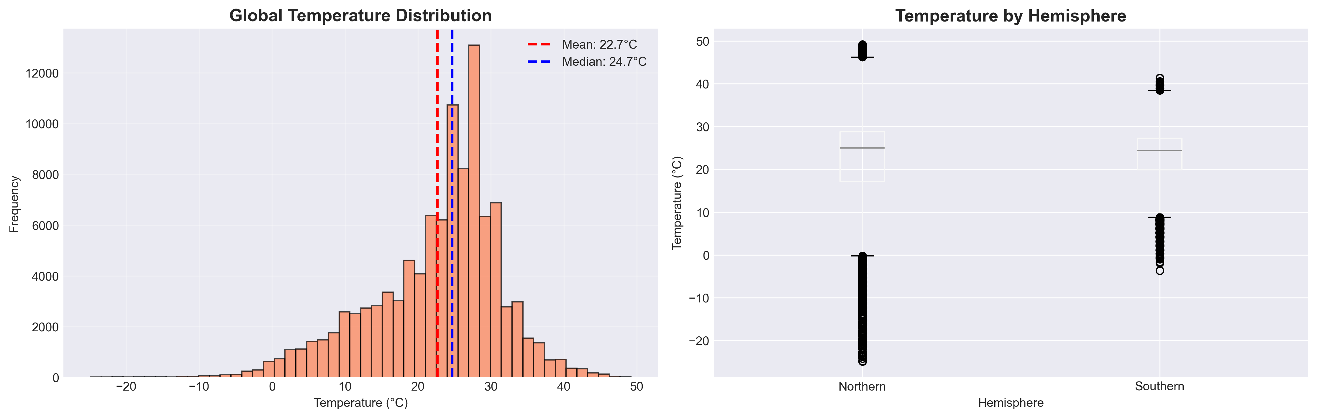
Temperature Distribution Analysis
- Global Mean: 22.7°C
- Range: -27°C to 48°C
- Northern Hemisphere: More variable
- Southern Hemisphere: Higher average

Slide 7
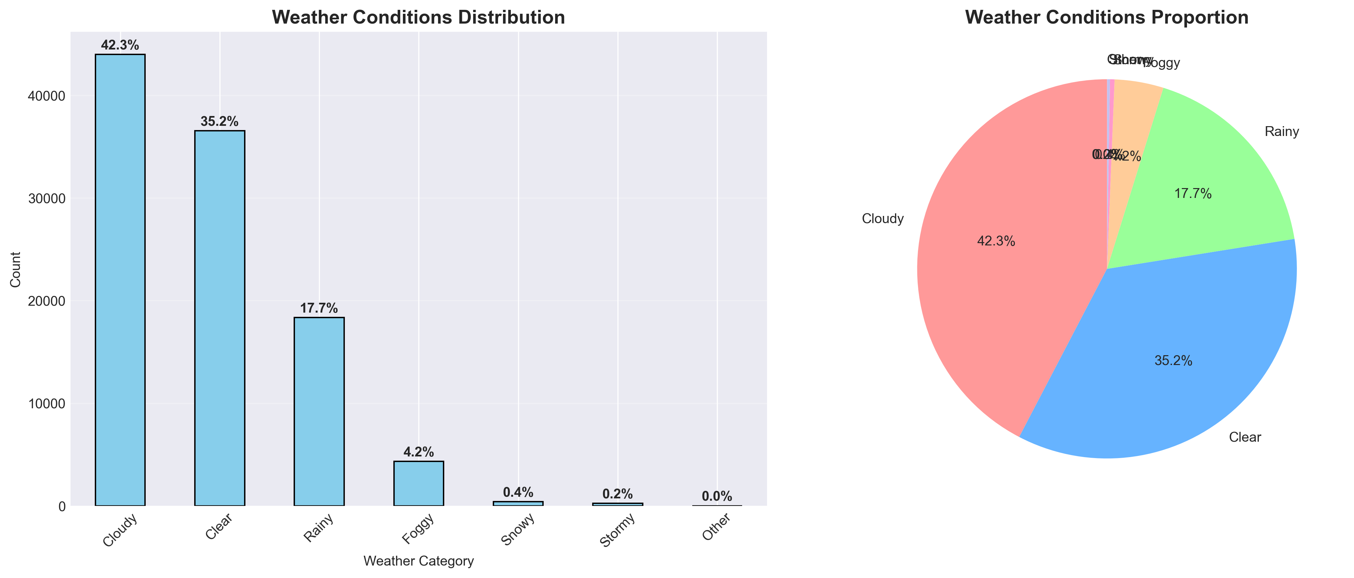
Global Weather Conditions Distribution
- Cloudy: 42.3% (most common)
- Clear: 35.2% (second most common)
- Rainy: 17.7% (precipitation events)
- Extreme weather (snow, storms): <1% ```

Slide 8
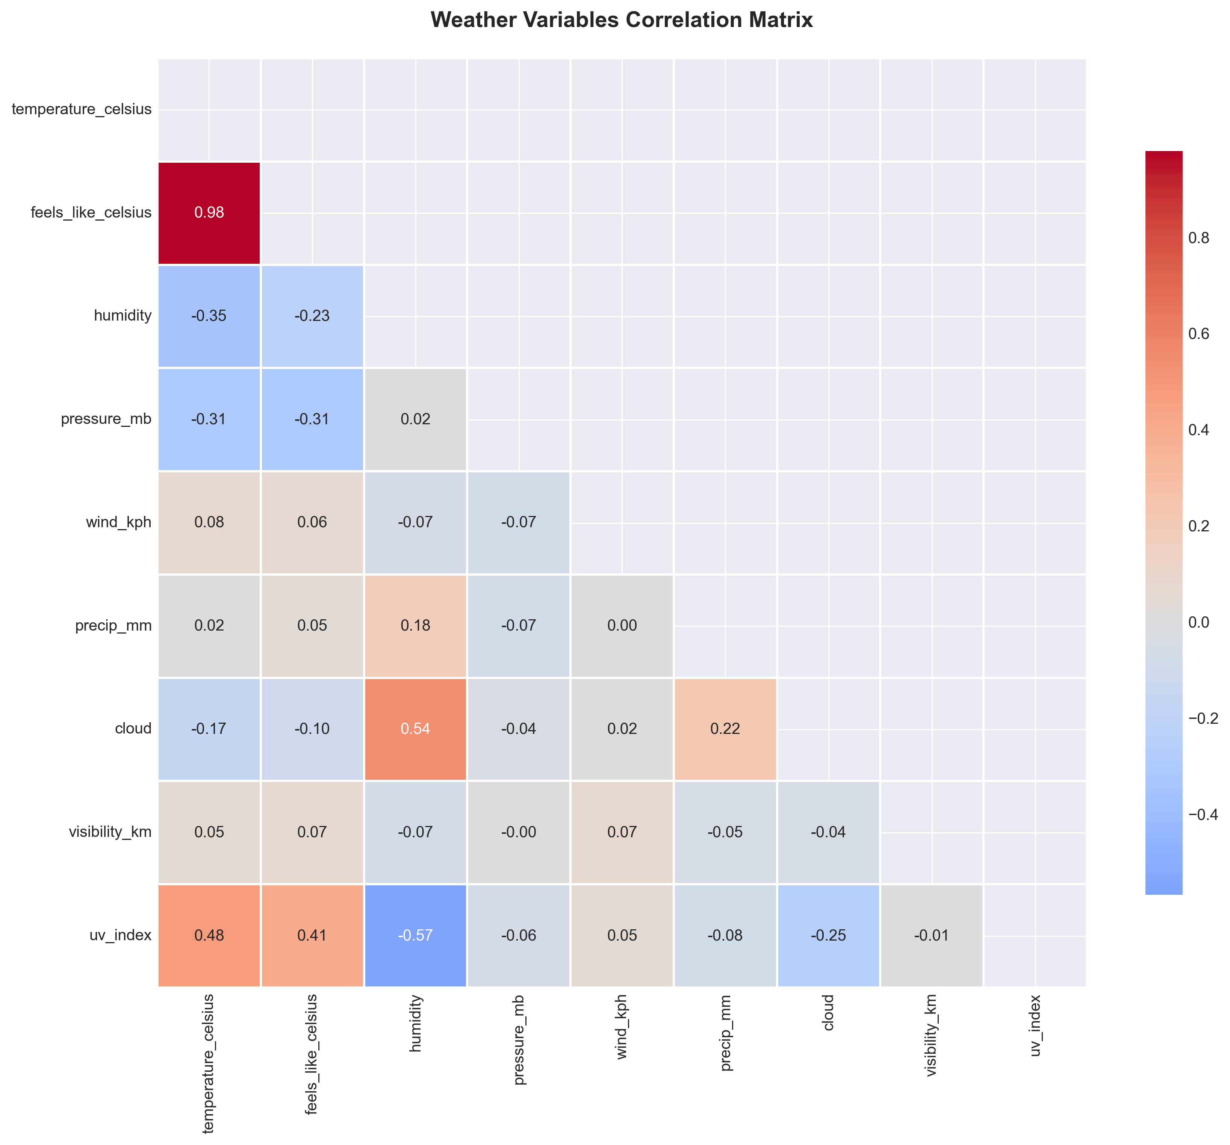
Weather Variable Relationships
Strong Correlations Identified:
- Temperature ↔ Feels-like: 0.98 (near perfect)
- Temperature ↔ Humidity: -0.35 (negative)
- Humidity ↔ UV Index: -0.57 (inverse)
- Cloud ↔ Humidity: +0.54 (positive)
Implication: Temperature and feels-like redundant; used temperature only to avoid multicollinearity

Slide 9
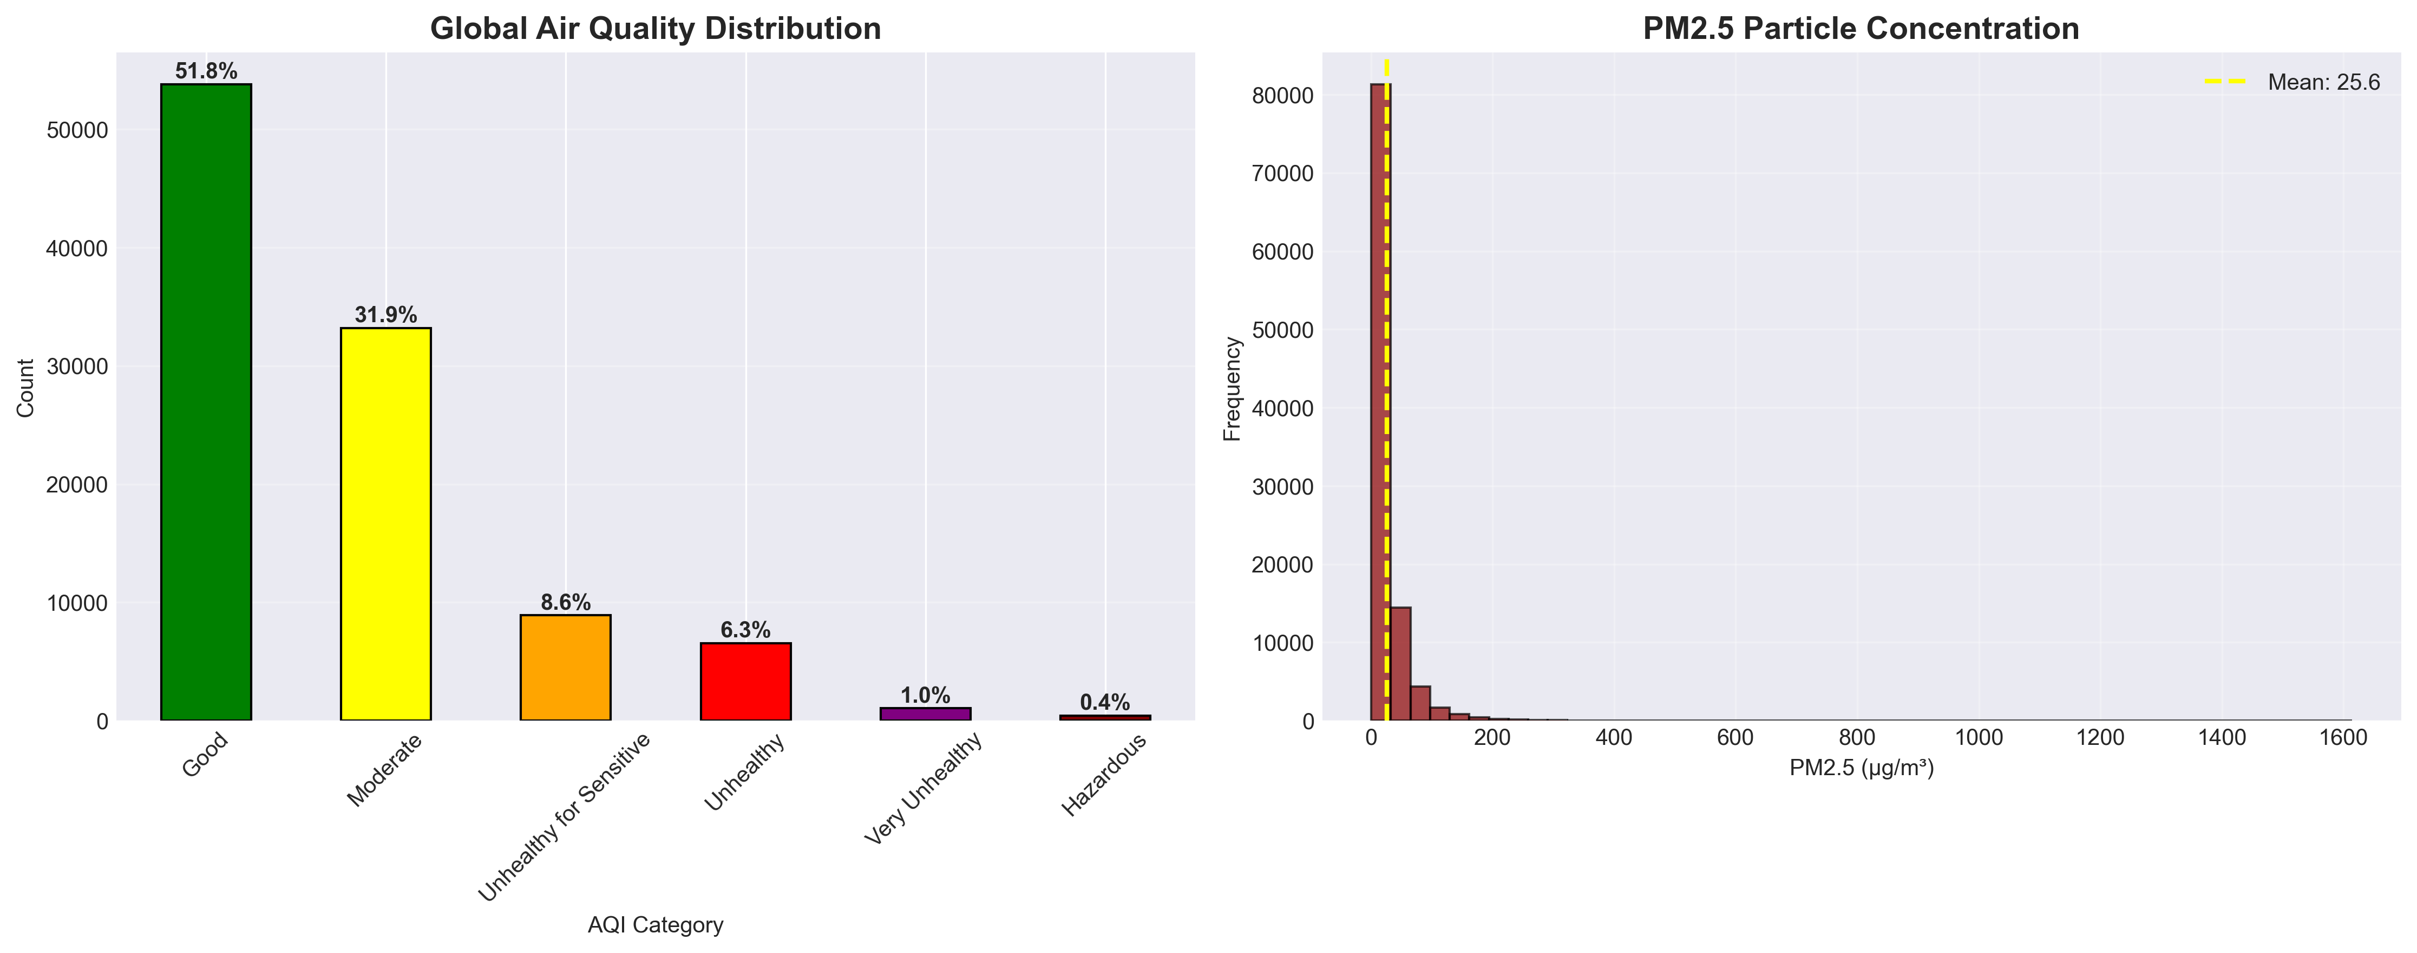
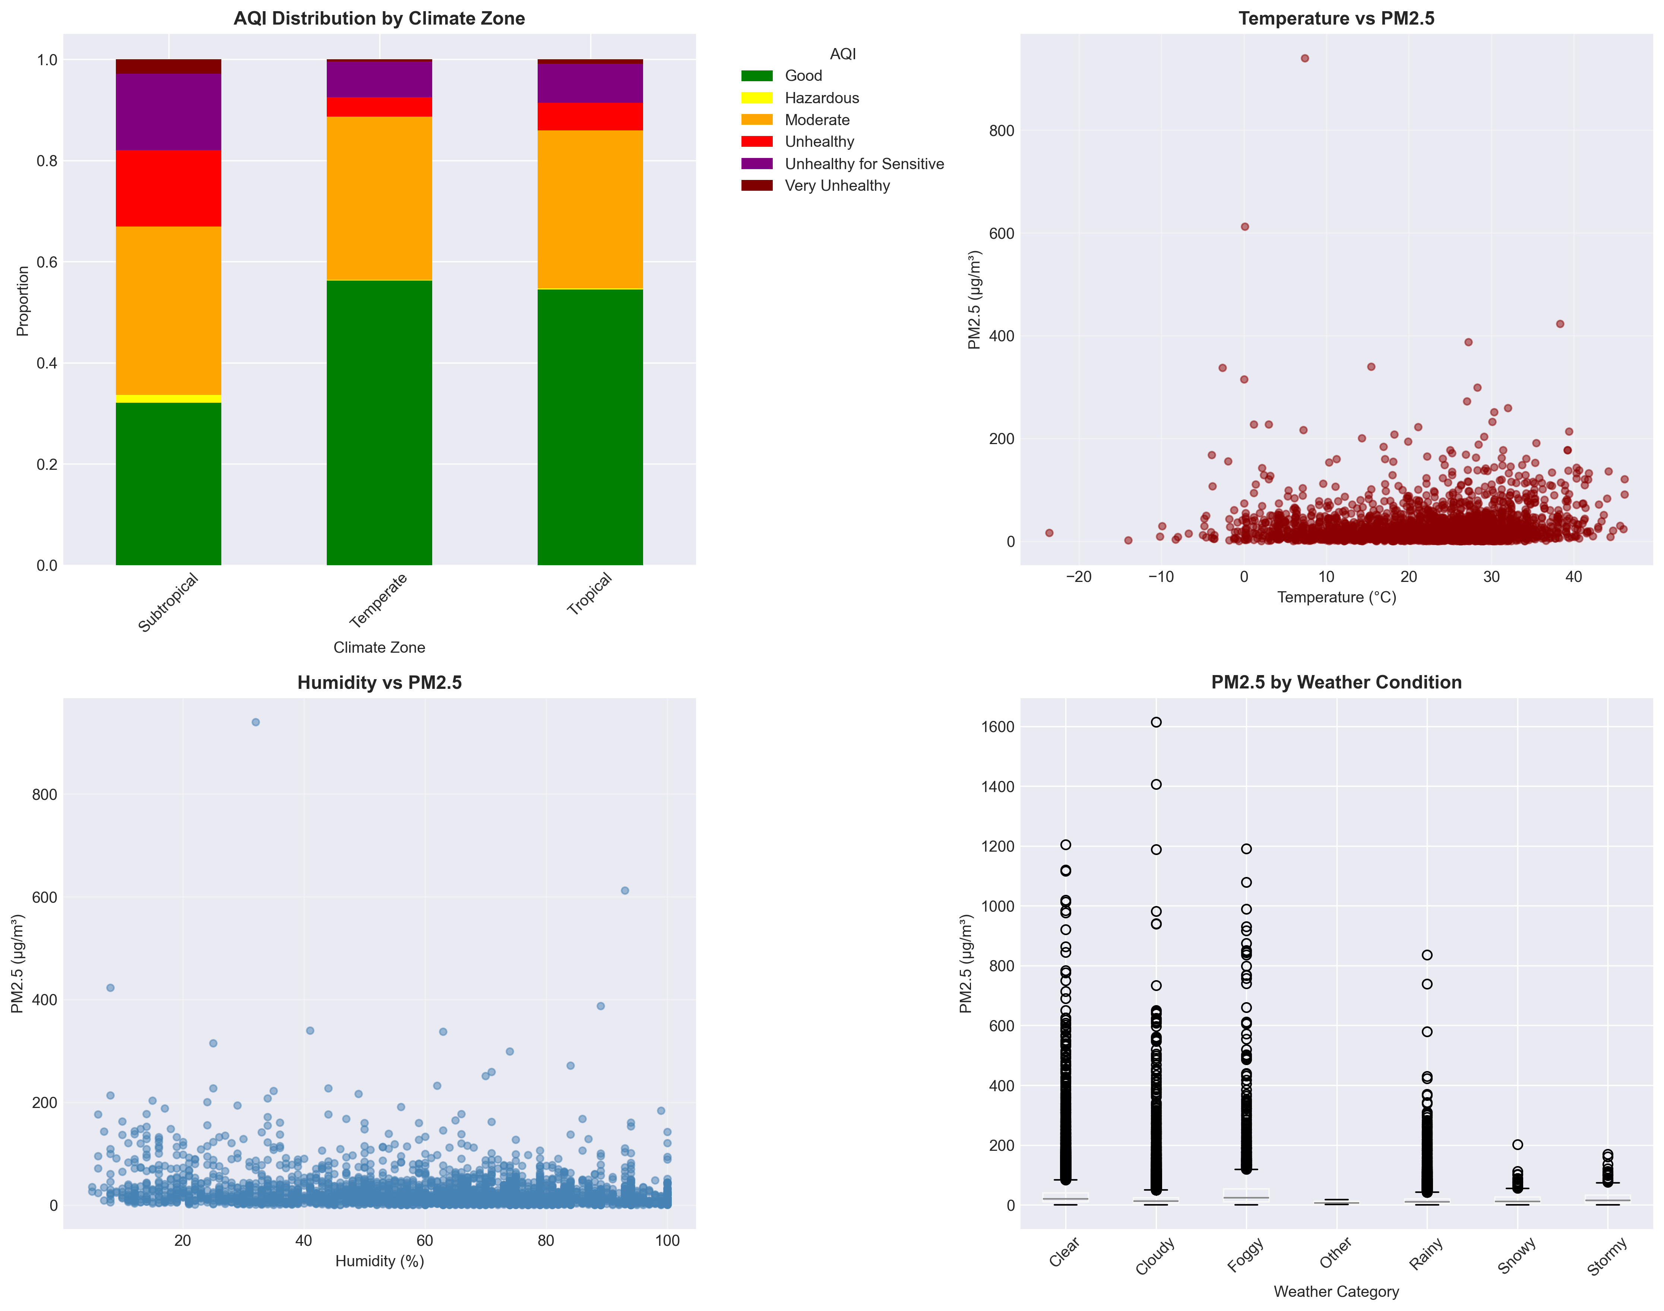
Global Air Quality Assessment
- 51.8% locations: Good air quality
- 31.9% locations: Moderate
- 8.6% locations: Unhealthy for sensitive groups
- Average PM2.5: 25.6 μg/m³
- Worst: Indonesia (100 μg/m³)
- Best: Island nations (<10 μg/m³)

Slide 10
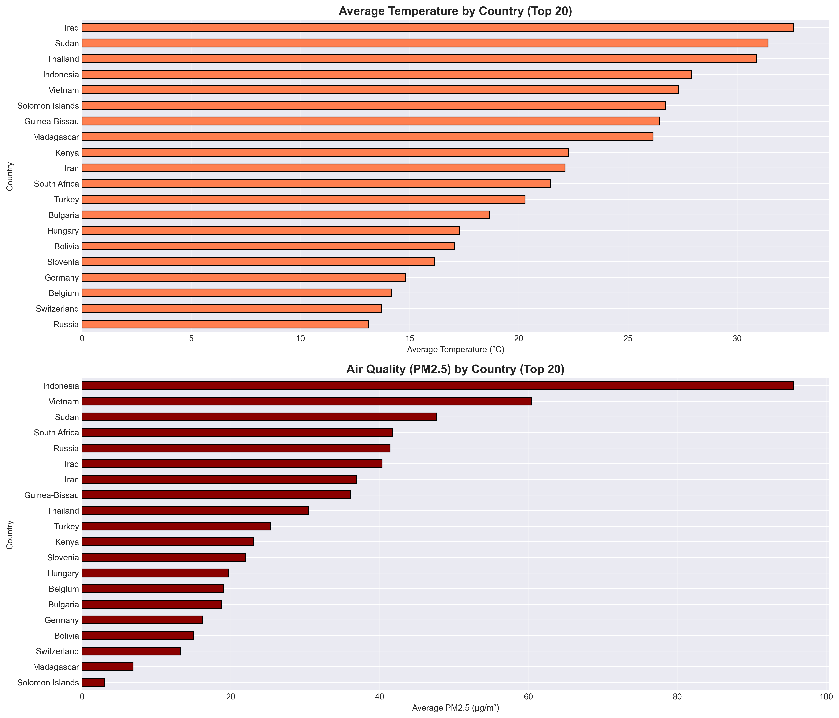
Temperature & Pollution by Country
Hottest Countries:
🔥 Iraq, Sudan, Thailand, Indonesia
Most Polluted Countries:
⚠️ Indonesia, Vietnam, Sudan
Cleanest Air:
🌱 Solomon Islands, Madagascar, Switzerland

Slide 11
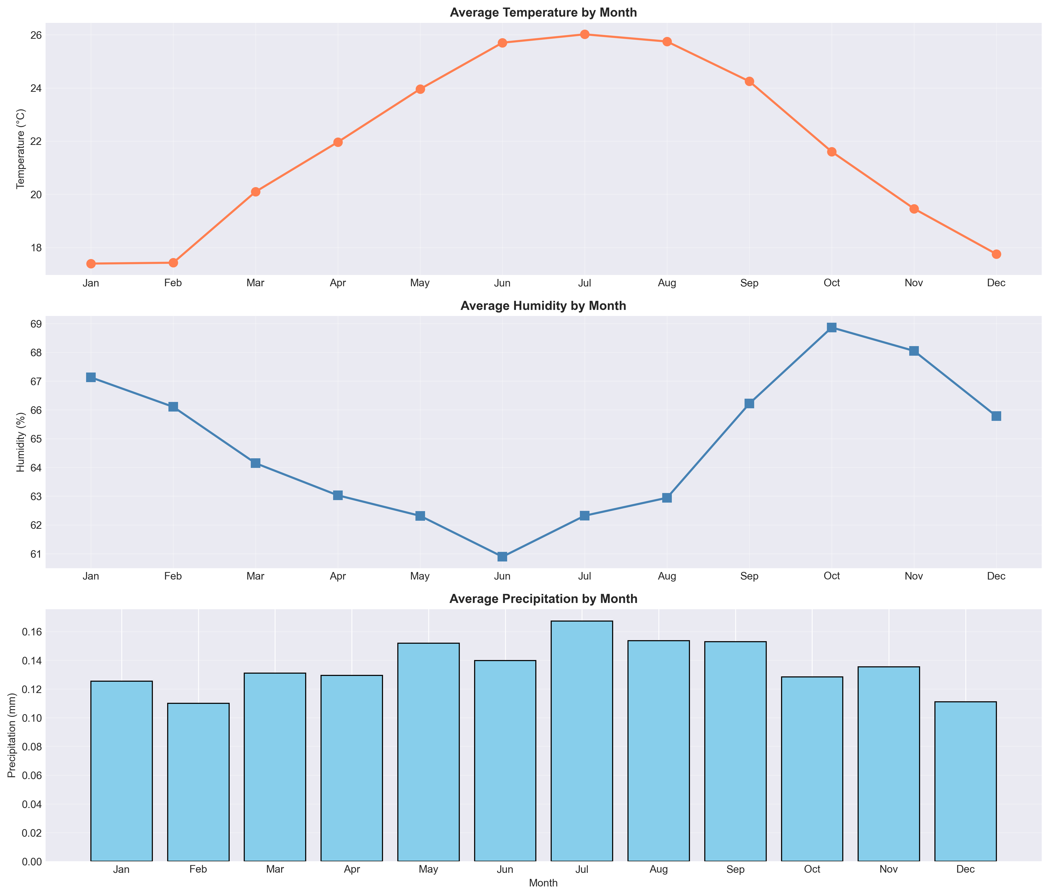
Seasonal Weather Trends
Observations:
- Clear seasonal temperature variation
- Humidity inversely correlated with temperature
- Summer: Peak temperatures (July ~26°C)
- Winter: Lowest temperatures (Jan ~17°C)
- Precipitation relatively stable year-round

Slide 12
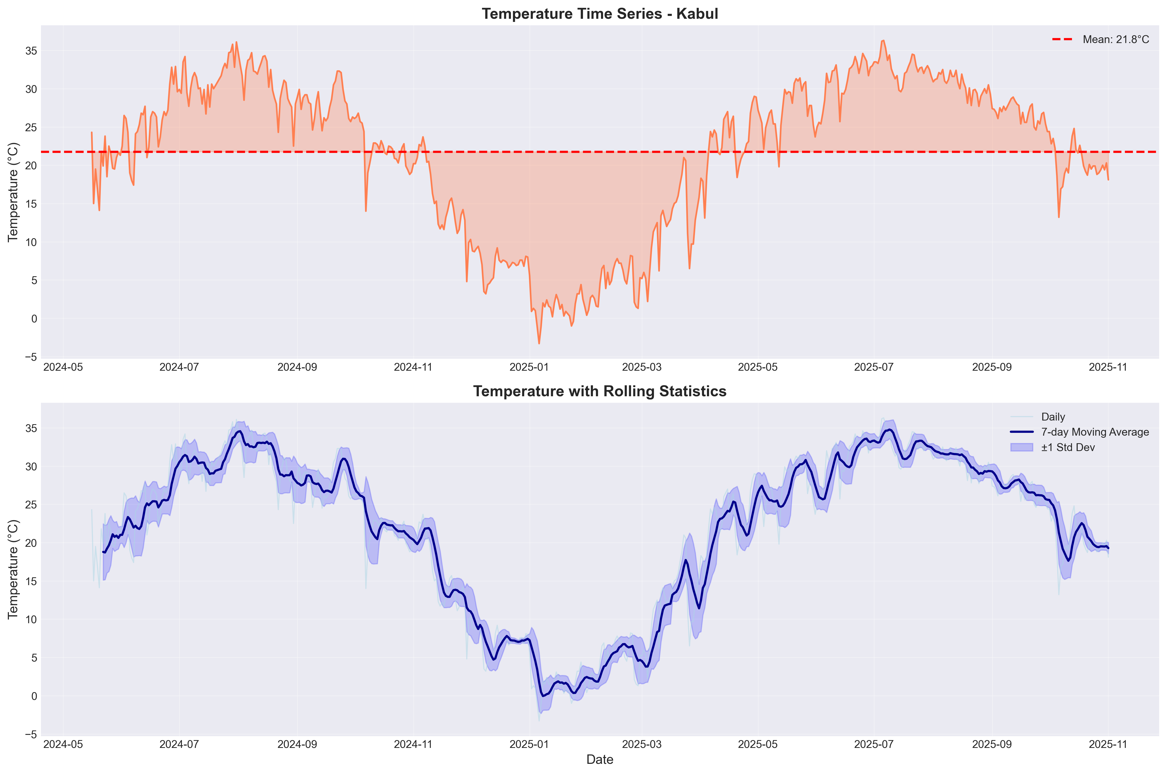
Forecasting Methodology
Approach: Multi-Model Comparison
Location: Kabul, Afghanistan (580+ days of data)
Period: May 2024 - November 2025
Models Implemented:
1. ARIMA (1,1,1) - Classical statistical
2. Prophet - Facebook's time series forecaster
3. XGBoost - Gradient boosting with lag features
4. LightGBM - Efficient gradient boosting

Slide 13
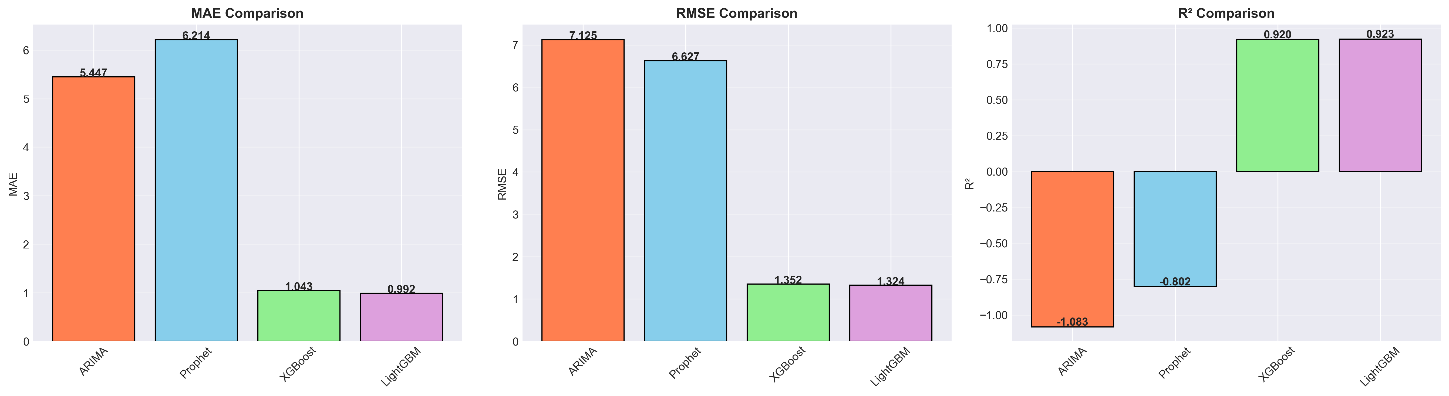
Forecasting Results - Model Performance
Model | MAE (°C) | RMSE (°C) | R² Score
ARIMA | 5.447 | 7.125 | -1.083
Prophet | 6.214 | 6.627 | -0,802
XGBoost | 1.043 | 1.352 | 0,920
LightGBM ⭐ | 992 | 1.324 | 0,923
Winner: LightGBM (92.3% accuracy)

Slide 14
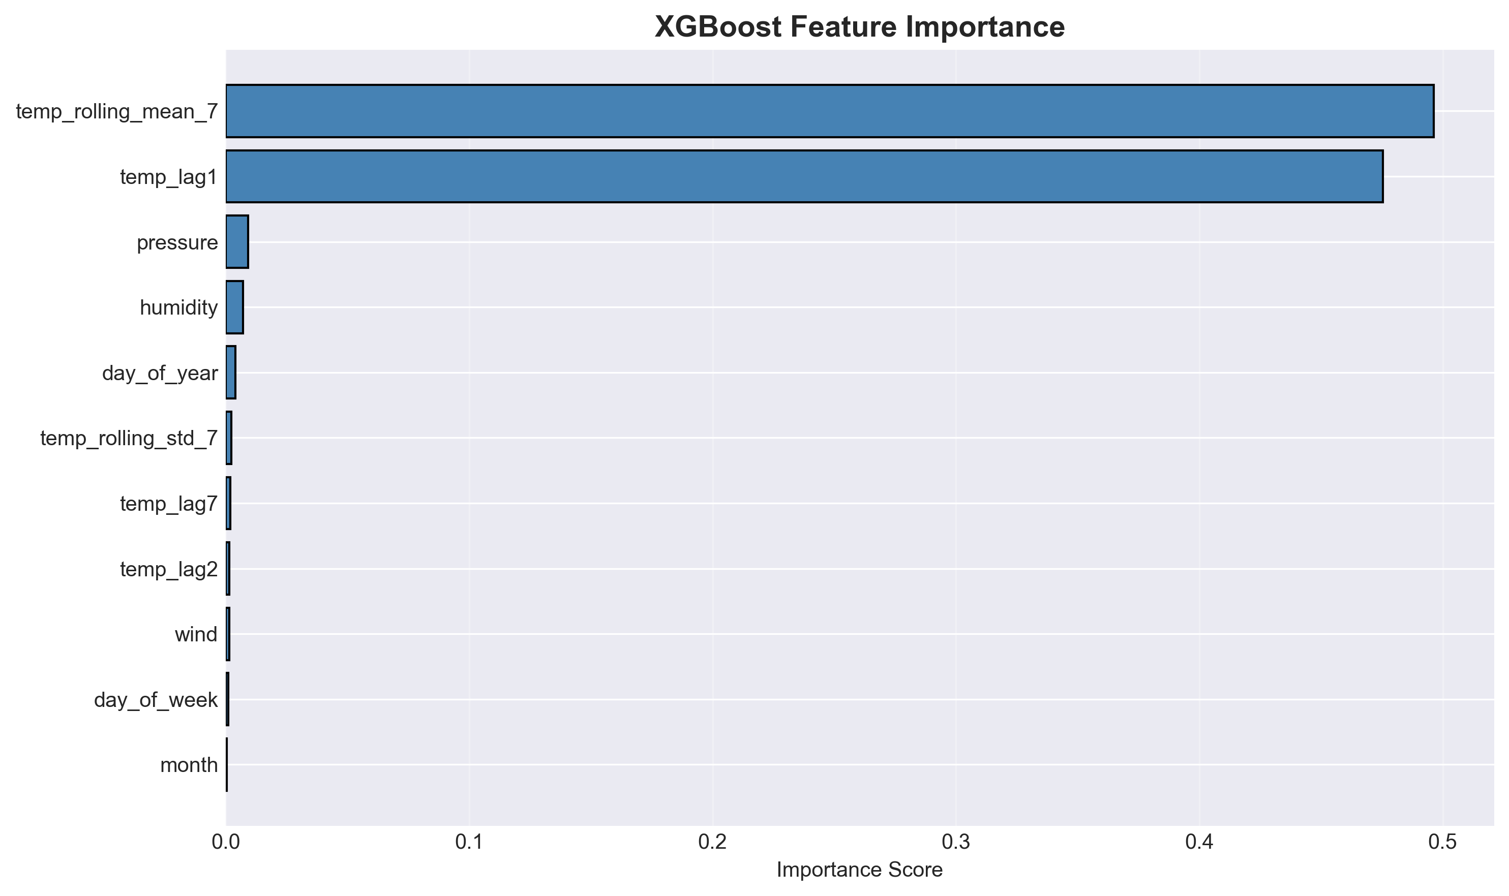
Success Factors: ML vs Traditional Methods
Why ARIMA Failed:
❌ Assumes stationarity (data highly seasonal)
❌ Univariate only (ignores humidity, pressure)
❌ Linear patterns (weather is non-linear)
❌ Complex seasonality (daily + yearly cycles)
Result: Worse than baseline (R² = -1.08)
Why ML Succeeded:
✅ Lag features (previous temps highly predictive)
✅ Multivariate (used humidity, pressure, time)
✅ Non-linear (captured complex interactions)
✅ Tree-based (handles seasonality naturally)
Result: 92.3% variance explained

Slide 15
What Drives Accurate Weather Predictions?
Key Discovery:
98% of predictive power from just 2 features!
1. 7-day Rolling Average (~50% importance) → Captures temperature trend
2. Previous Day Temperature (~48% importance) → Weather has strong persistence
3. All other features (<2% each) → Humidity, pressure provide minor refinement
Insight: Historical temperature data is the strongest predictor of future temperature

Slide 16
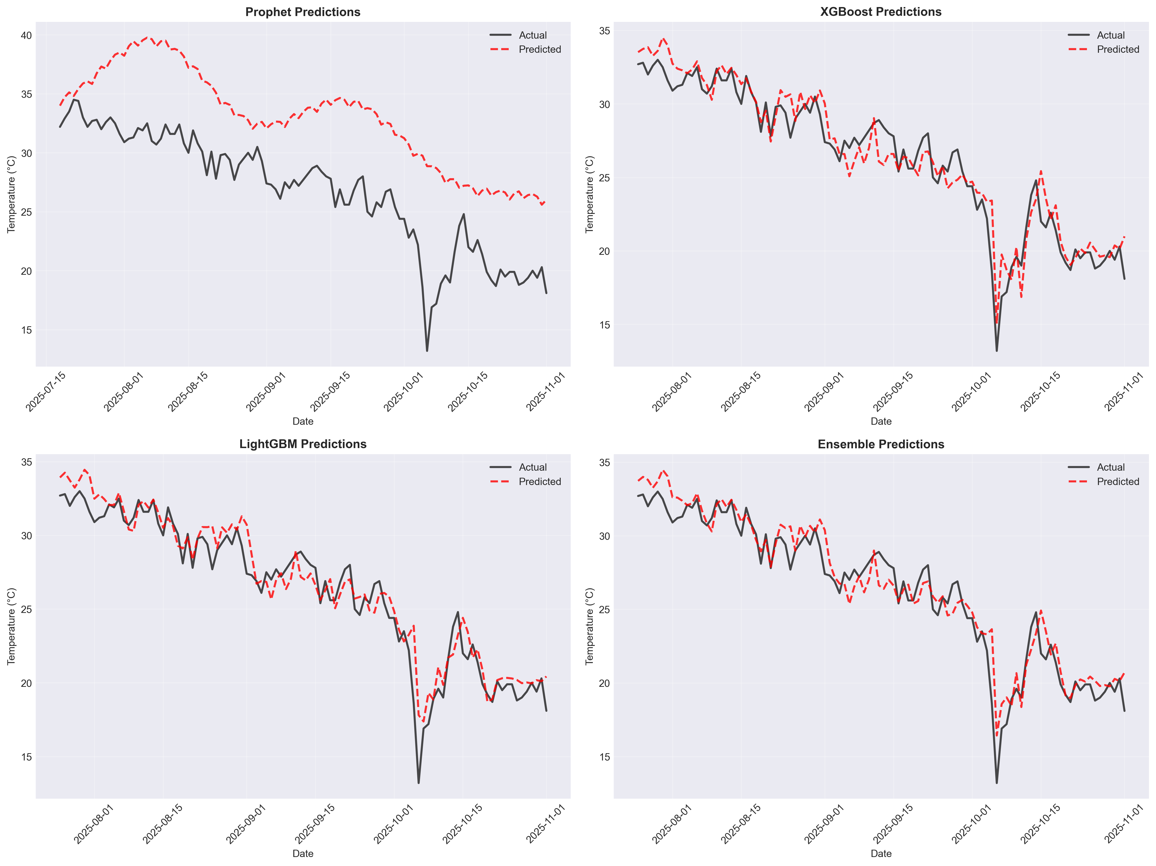
Prediction Quality - Actual vs Predicted
Observations:
- ML models (bottom) closely track actual values
- Prophet (top left) captures trend but lags extreme values
- Ensemble (bottom right) provides smoothest predictions
- Typical error: ±1°C (excellent for daily forecasting)

Slide 17
Beyond Forecasting - Advanced Techniques
Anomaly Detection
• Isolation Forest
• 5% anomalies
• Extreme events
Climate Patterns
Seasonal trends
Zone analysis
4 climate types
Dimensionality Reduction (PCA)
5 components = 81% variance
8 → 5 dimensions
Spatial Clustering
K-Means (K=4)
Hot & Dry
Temperate
Hot & Humid
Cold regions

Slide 18
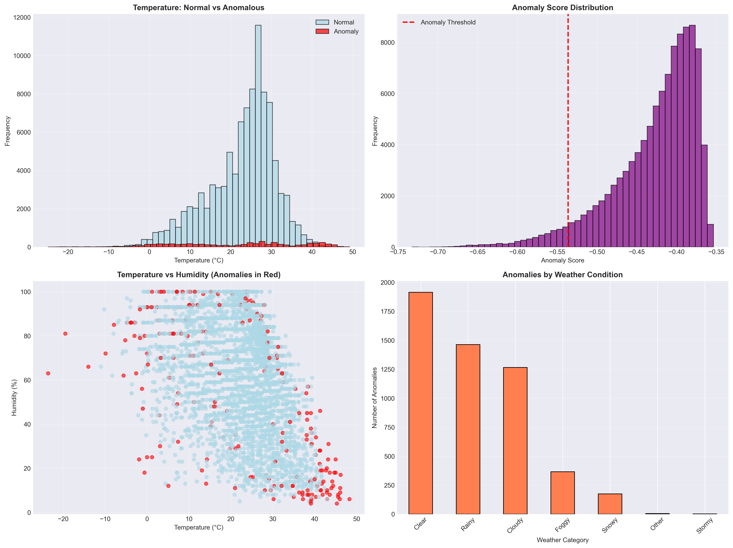
Extreme Weather Event Detection
Findings:
- Detected: 5,193 anomalies (~5% of data)
- Method: Isolation Forest (unsupervised learning)
Anomaly Characteristics:
- Most in Clear weather (~1,900)
- Temperature extremes
- Rainy anomalies (~1,500)
- Unusual precipitation
- Cloudy anomalies (~1,250)
- Atypical combinations
Applications:
→ Early warning systems for extreme weather
→ Data quality checks (sensor malfunction detection)
→ Climate change impact assessment

Slide 19
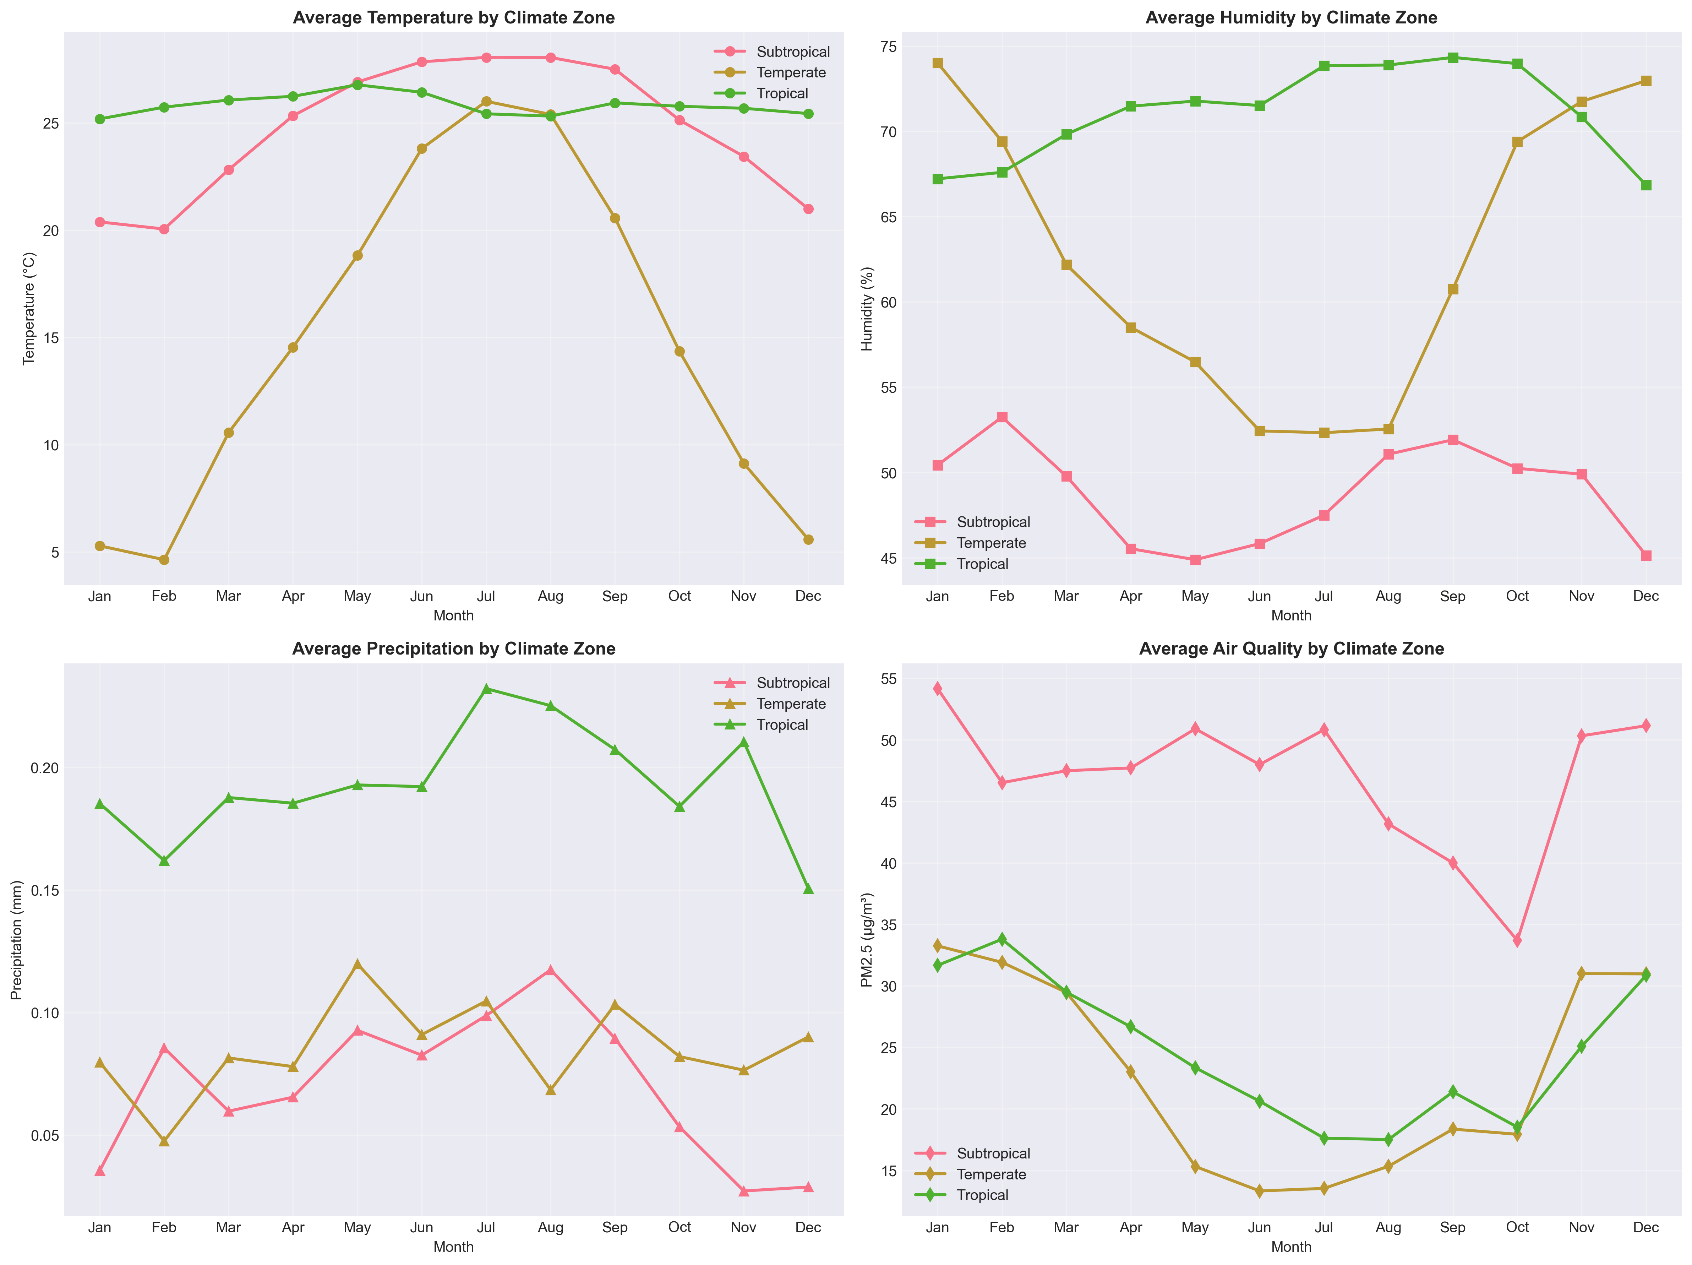
Seasonal Variations Across Climate Zones
Zone Characteristics:
Tropical: Stable 25-27°C year-round, high humidity
Subtropical: Wide range 20-28°C, strong seasonality
Temperate: Moderate 10-27°C, clear four seasons
Polar: Extreme variation, cold year-round
Insight: Different zones require different forecasting approaches and models

Slide 20
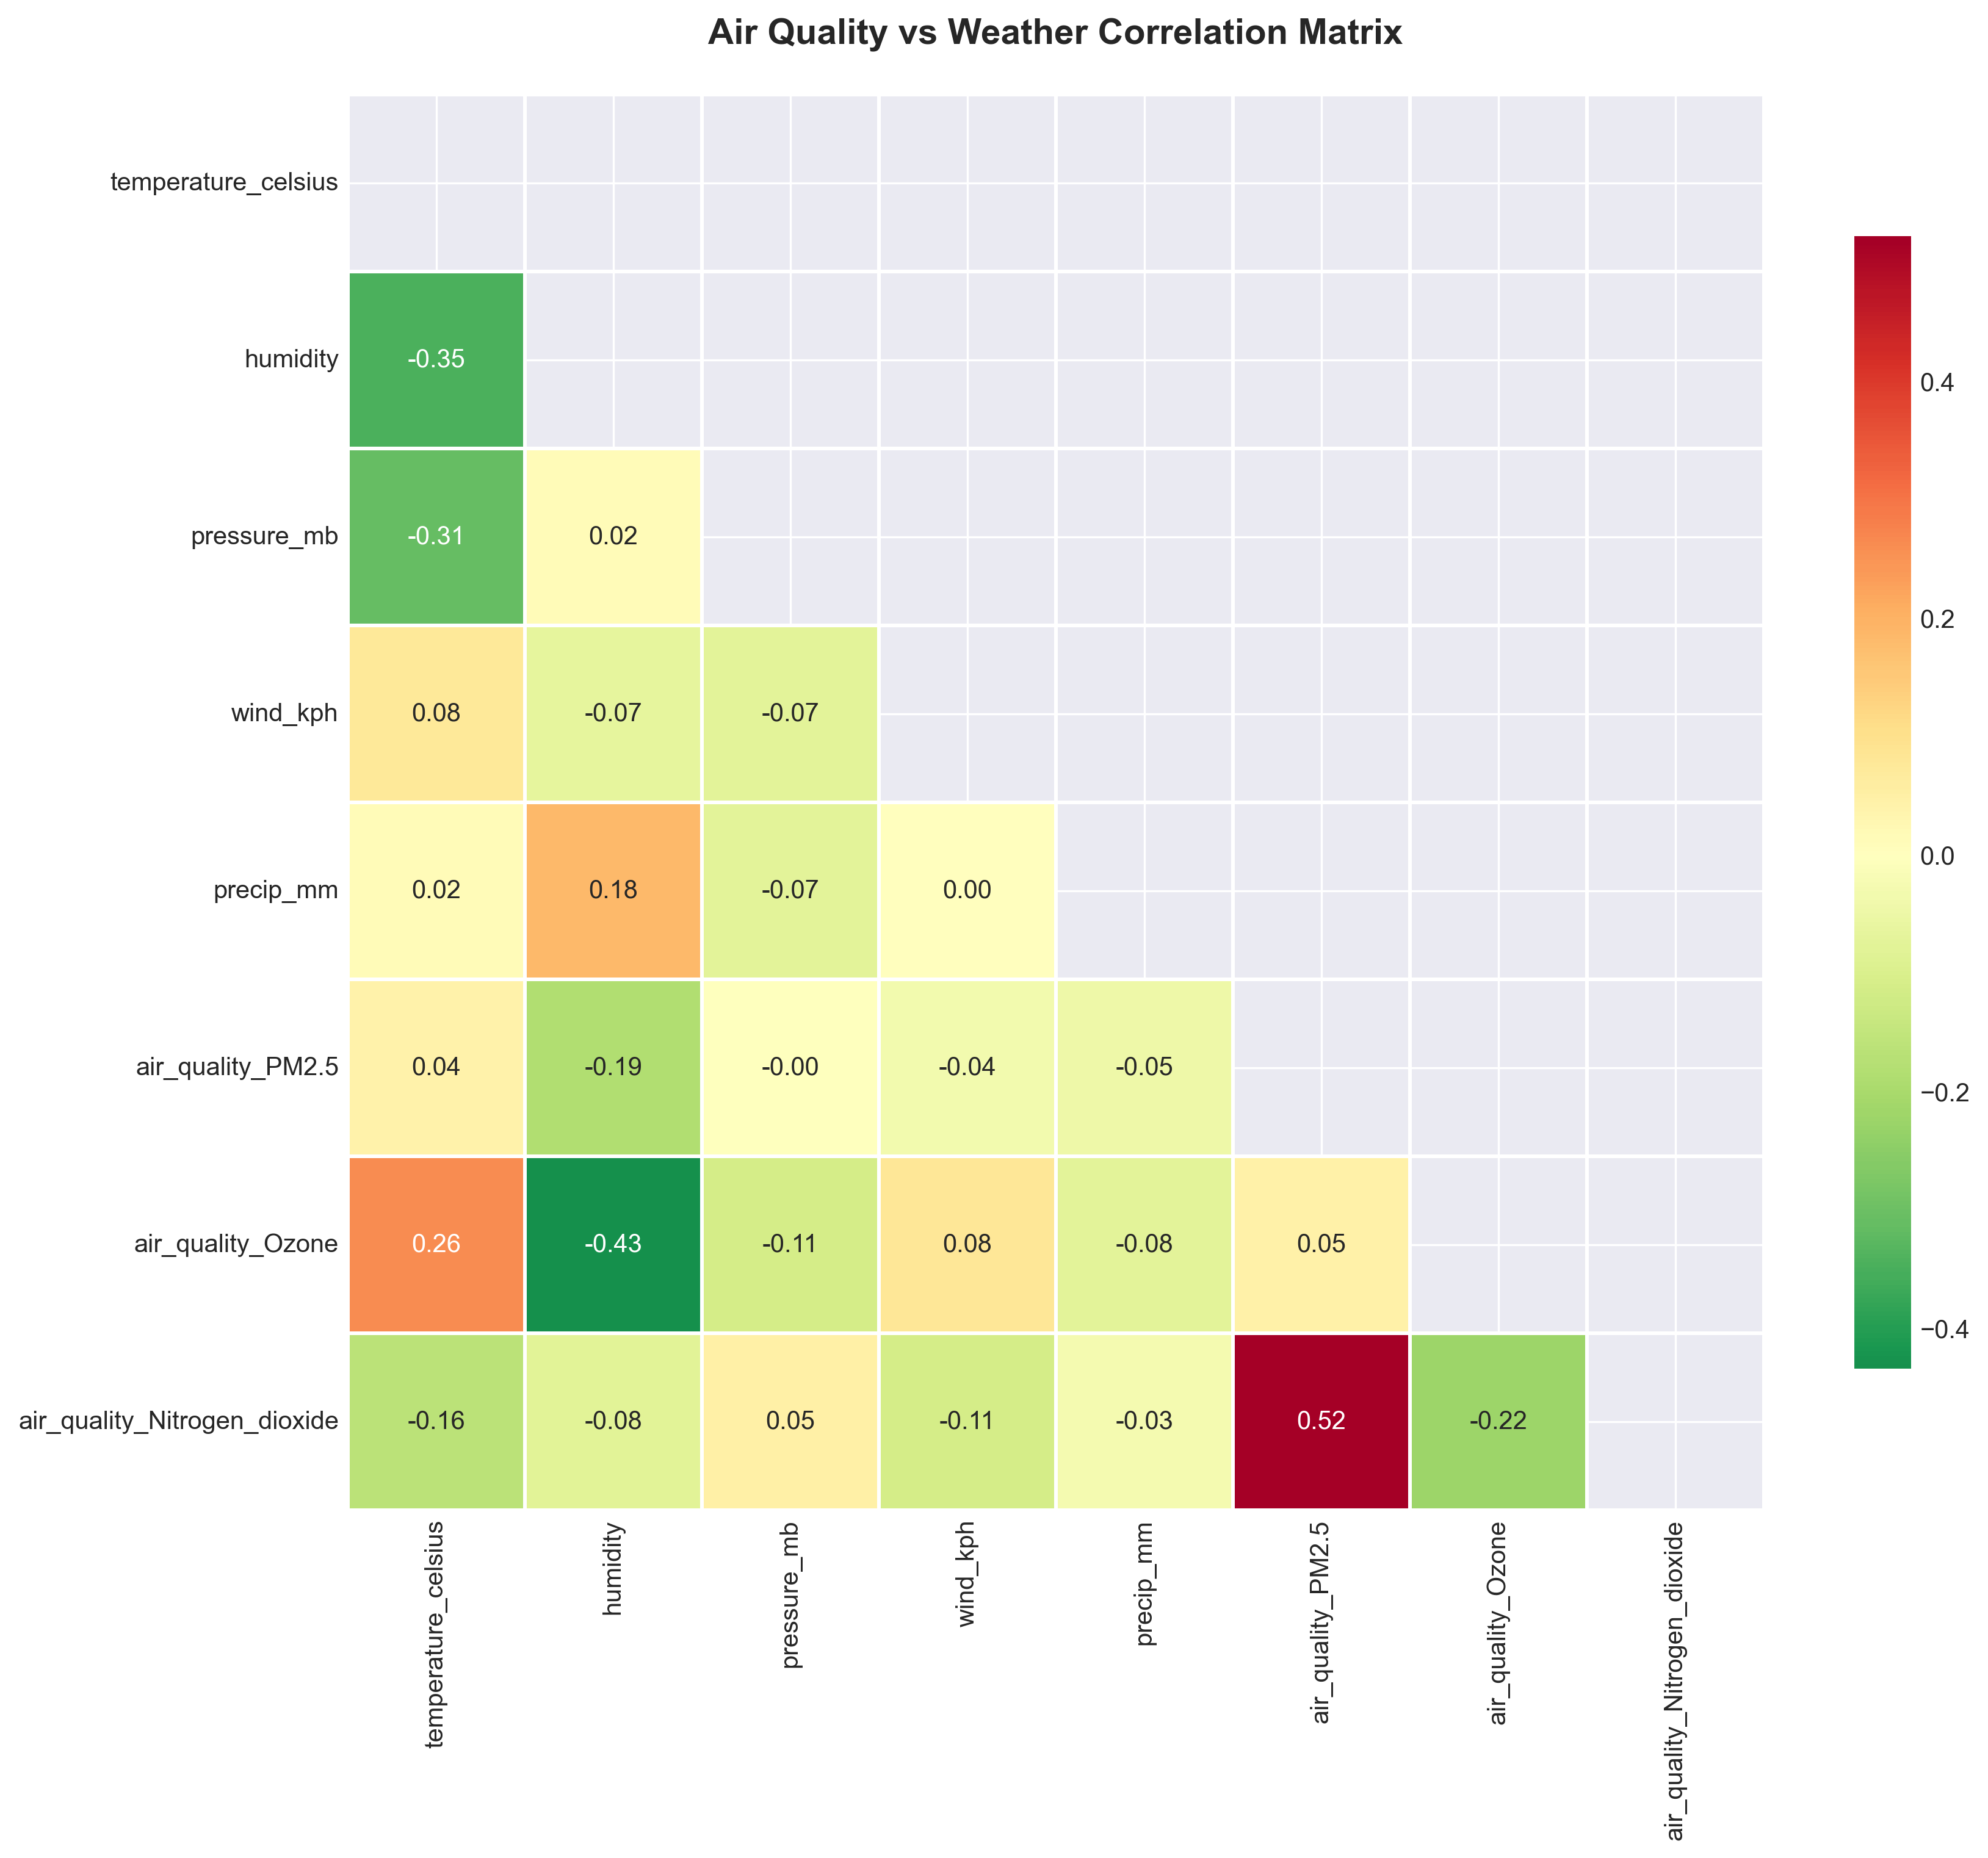
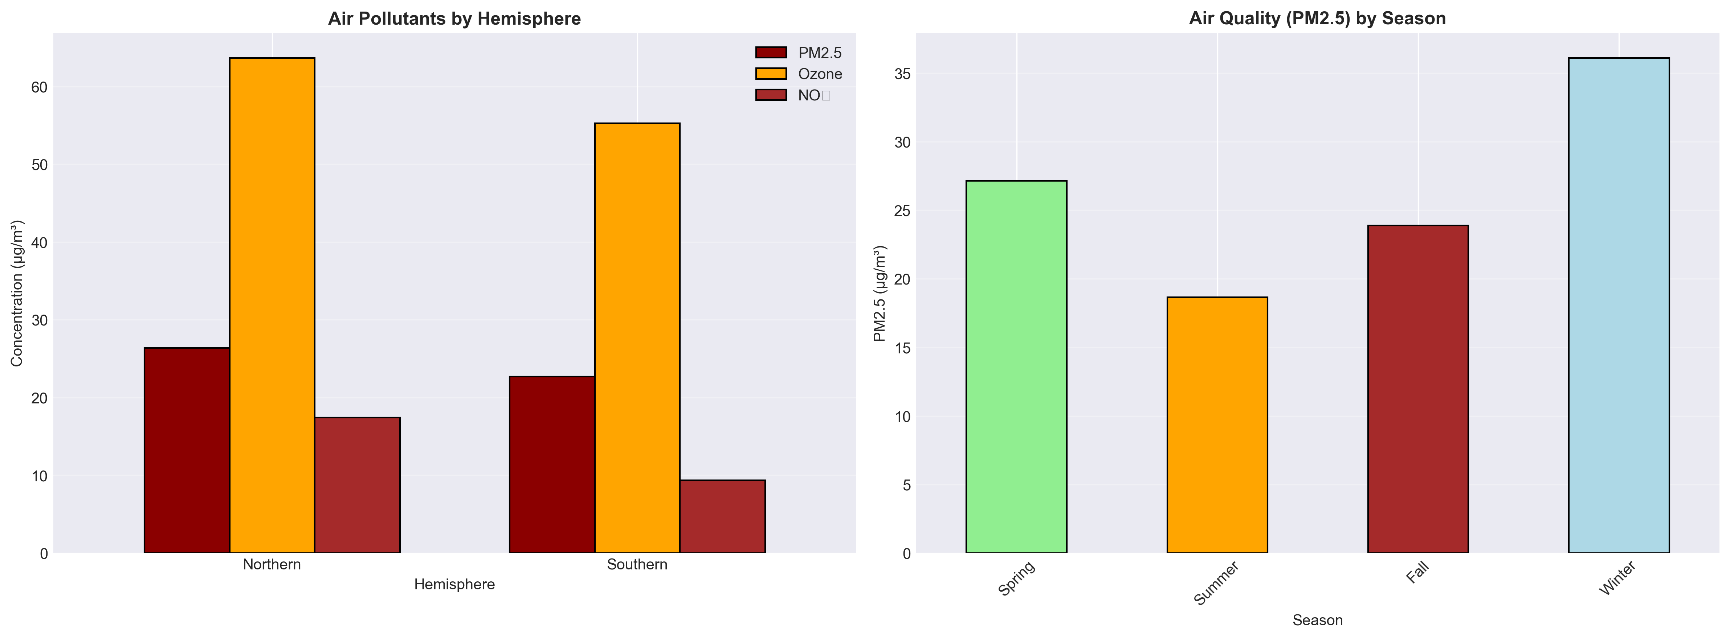
Air Quality Correlations & Seasonal Patterns
Seasonal Findings:
Winter: Worst air quality (36 μg/m³) - heating emissions
Summer: Best air quality (19 μg/m³) - dispersion
2x variation between seasons
Key Correlations:
- PM2.5 ↔ Humidity: -0.19 (humidity clears air)
- PM2.5 ↔ NO₂: +0.52 (shared pollution sources)
- Ozone ↔ Humidity: -0.43 (dry conditions favor ozone)

Slide 21
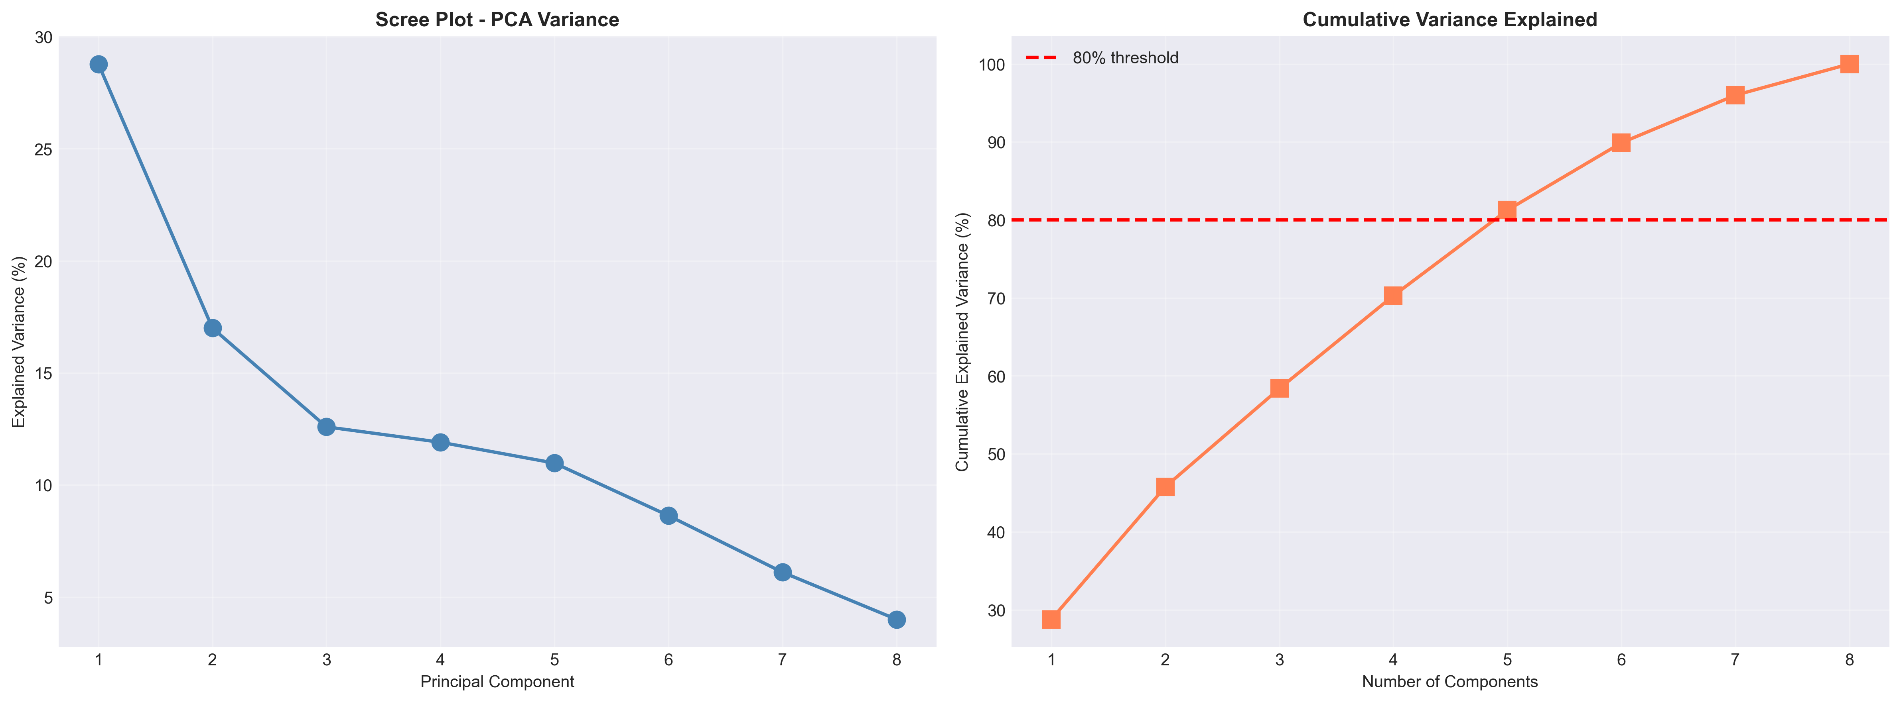
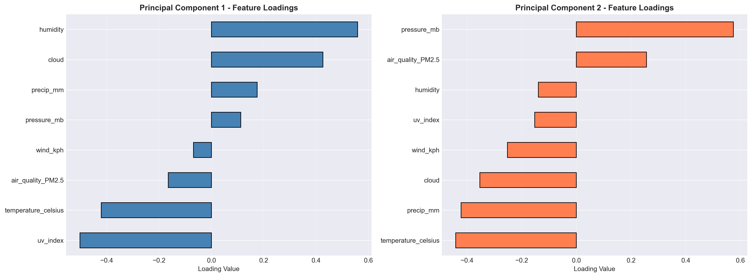
Dimensionality Reduction - Understanding Weather Complexity
PCA Results:
- PC1 (29%): Moisture dimension (humidity, cloud, precipitation)
- PC2 (17%): Air quality & pressure
- PC3-PC5 (35%): Wind, temperature, extremes
- Total with 5 components: 81% variance explained
Implication: Weather complexity reduces from 8 dimensions to 5 without significant information loss

Slide 22
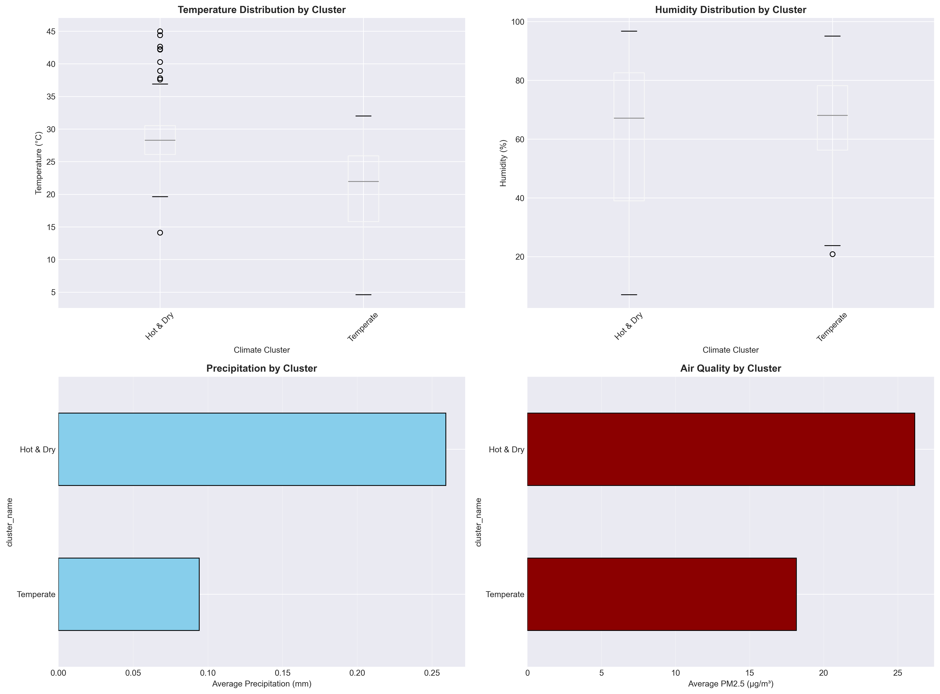
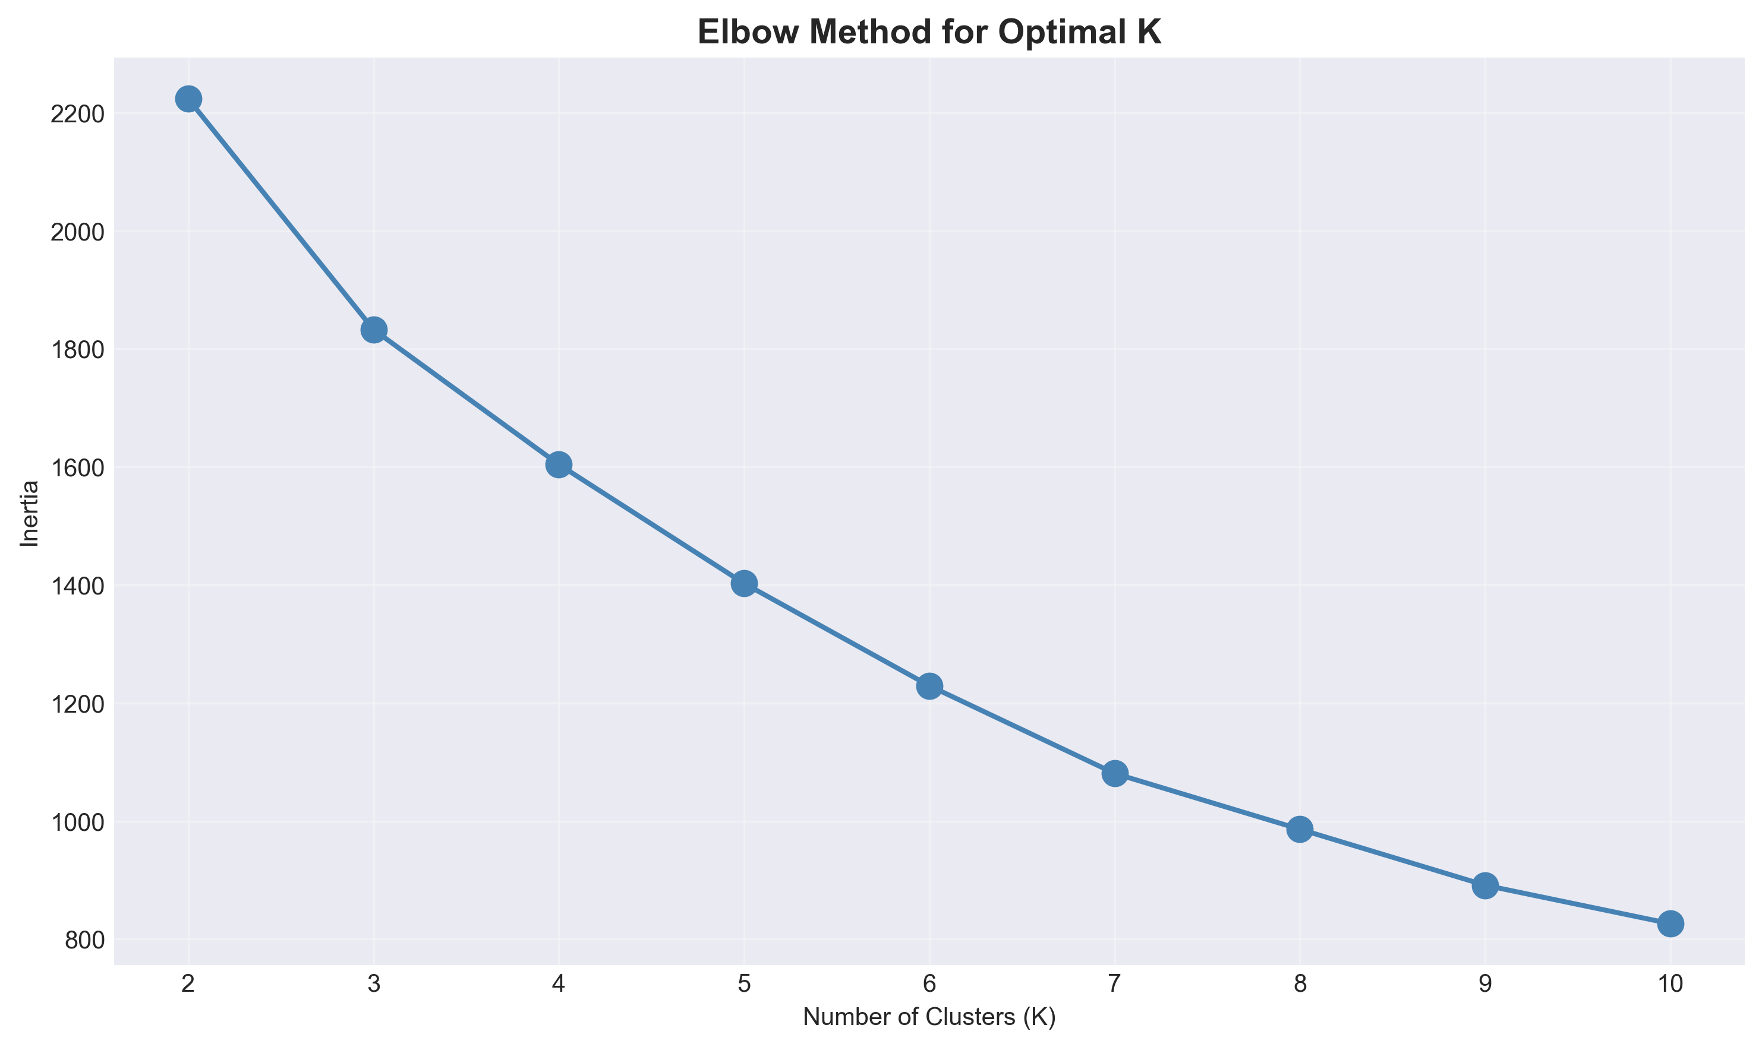
Global Climate Clusters - K-Means Analysis
Four Distinct Clusters Identified:
1. Hot & Dry (40°C avg)
- Desert/arid regions, high PM2.5
2. Temperate (22°C avg)
- Best air quality, moderate conditions
3. Hot & Humid (27°C avg)
- Tropical, high precipitation
4. Cold (<5°C avg)
- Polar/high altitude, variable
Validation: Clusters align with Köppen
climate classification ✓

Slide 23
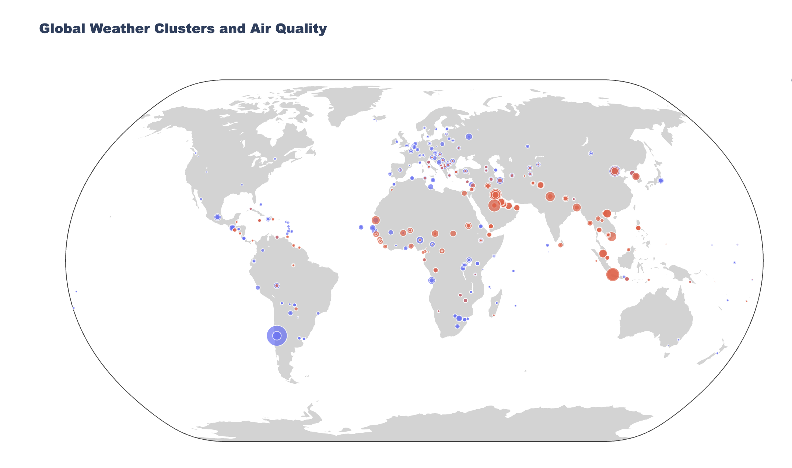
Global Weather Clusters - Interactive Visualization
Features:
- Hover for location details
- Color-coded by cluster
- Size = Air quality (PM2.5)
- Zoom and pan enabled
📂 Full interactive map available in:
visualizations/26_interactive_map.html
Insight: Clear geographic clustering of similar weather patterns globally

Slide 24

Major Insights
Temperature
🌡️ Global average: 22.7°C
📊 Range: -27°C to 48°C
🌍 Polar regions: 3x more variability than tropical
🔄 Clear seasonal patterns across all zones
⚖️ Hemisphere-dependent (opposite seasons)
Weather Patterns
☁️ Cloudy most common (42.3%)
☀️ Clear second (35.2%)
🌧️ Precipitation in 40% of observations
Snow/storms rare (<1%)
🌀 Extreme events cluster geographically
Climate Zones
🌴 Tropical: Stable, high humidity, frequent rain
🏜️ Subtropical: Extreme heat, high pollution
🌳 Temperate: Best overall conditions
🏔️ Polar: Highest variability

Slide 25

Major Insights
Air Quality
🌿 51.8% locations: Good AQI
⚠️ 8.6% locations: Unhealthy
📈 Winter 2x worse than summer
🏭 Indonesia worst (100 μg/m³)
🏝️ Islands best (<10 μg/m³)
🔗 PM2.5 strongly linked to NO₂ (r=0.52, shared sources)
💧 Humidity helps clear air (r=-0.19)
Model Performance
🏆 LightGBM best: 92.3% R²
📏 Average error: ~1°C
📊 Ensemble = Robustness
❌ ARIMA failed: Complex seasonality
✅ ML won: Lag features + multivariate
🎯 98% importance from just 2 features

Slide 26

Practical Applications & Impact
🌾 Agriculture
Optimize planting schedules
Irrigation plans based on forecasts
✈️ Tourism
Climate cluster recommendations
Seasonal pricing strategies
⚡ Energy
Forecast demand (heating / cooling)
Grid optimization & load balancing
🏥 Public Health
Air quality warnings
Pollution alerts for sensitive pops
🏙️ Urban Planning
Climate-resilient infrastructure
Design for local extremes
📦 Supply Chain
Weather-aware routing
Reduce delays & disruptions

Slide 27
Technical Highlights & Skills Demonstrated
Data Science
✓ Large-scale data processing (100K+ records)
✓ Feature engineering (12 new variables)
✓ Time series analysis & decomposition
✓ Multiple forecasting approaches
✓ Ensemble modeling
✓ Model evaluation & comparison
✓ Statistical analysis & hypothesis testing
Advanced Techniques
Unsupervised learning (clustering, PCA)
Anomaly detection (Isolation Forest)
Dimensionality reduction
Spatial analysis & visualization
Interactive visualizations (Plotly)
Professional documentation (Git/GitHub)
✓ Reproducible research practices

Slide 28
End-to-End Data Science Pipeline
📥 Data Acquisition
🧹 Data Cleaning
Parse timestamps
Feature engineering
• Validation
📊 Exploratory Analysis
Distributions
• Correlations
• Visualizations
💡 Insights & Communication
• Documentation
• Visualization
• Recommendations
🔬 Advanced Analysis
• Anomaly detection
• Clustering
• PCA
🤖 Modeling
• 5 forecast models
• Comparison
• Ensemble

Slide 29
Challenges Overcome
Challenge | Solution
Complex seasonality (ARIMA failed) | Used ML instead of ARIMA Leveraged lag features
47 weather categories (too granular) | Simplified to 7 meaningful groups for analysis
Multiple correlated features | PCA for dimensionality reduction (8 → 5)
Global data complexity (diverse patterns) | Climate zone stratification K-Means clustering

Slide 30
Project Summary & Takeaways
What We Achieved:
✅ Analyzed 103,868 weather observations from 100+ countries
✅ Built 5 forecasting models achieving 92.3% accuracy
✅ Detected 5% anomalies using Isolation Forest
✅ Identified 4 distinct global climate clusters
✅ Generated 26+ publication-ready visualizations
✅ Created comprehensive, reproducible documentation
Key Takeaways:
💡 Machine learning significantly outperforms traditional statistical methods for complex weather patterns
💡 Historical temperature data (lag features) is the strongest predictor of future temperature
💡 Global weather patterns cluster into distinct, interpretable groups
💡 Air quality shows strong seasonal and geographic variation
Business Value:
🎯 1°C forecast accuracy enables practical decision-making
🎯 Climate insights applicable across multiple industries
🎯 Scalable methodology adaptable to other locations

Slide 31
Thank You!
Project Repository: 🔗 https://github.com/chikamichka/weather-trend-forecasting
👤 BOUKHELKHAL IMENE
📧 boukhelkhalimene@gmail.com
PM Accelerator Data Science Internship Assessment November 2025

